Slide 1
REGION BASED CONVOLUTIONAL NEURAL NETWORKS
By:
Ajay Dinakar Kandavalli
Nikhil Vangeti

Slide 2
Contents
Region Based CNN’s
R-CNN
An Early Application of CNN to Object Detection
Goal
Overview
Problems
Fast R-CNN
Insight 1:RoI Pooling
Insight 2:Combine all modules into One Network
Over view
Problems
Faster R-CNN
Proposal networks
Results

Slide 3
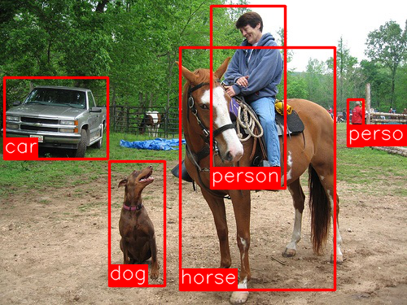
R-CNN - An Early Application of CNNs to Object Detection
Proposed by Ross Girshick , Jeff Donahue, and Trevor Darrel and jitendra malik in 2014.
Object detection is the task of finding the different objects in an image and classifying them (as seen in the image right side).
this problem can be solved with Krizhevsky’s results by testing on the PASCAL VOC Challenge in 2012, a popular object detection challenge akin to ImageNet

Slide 4
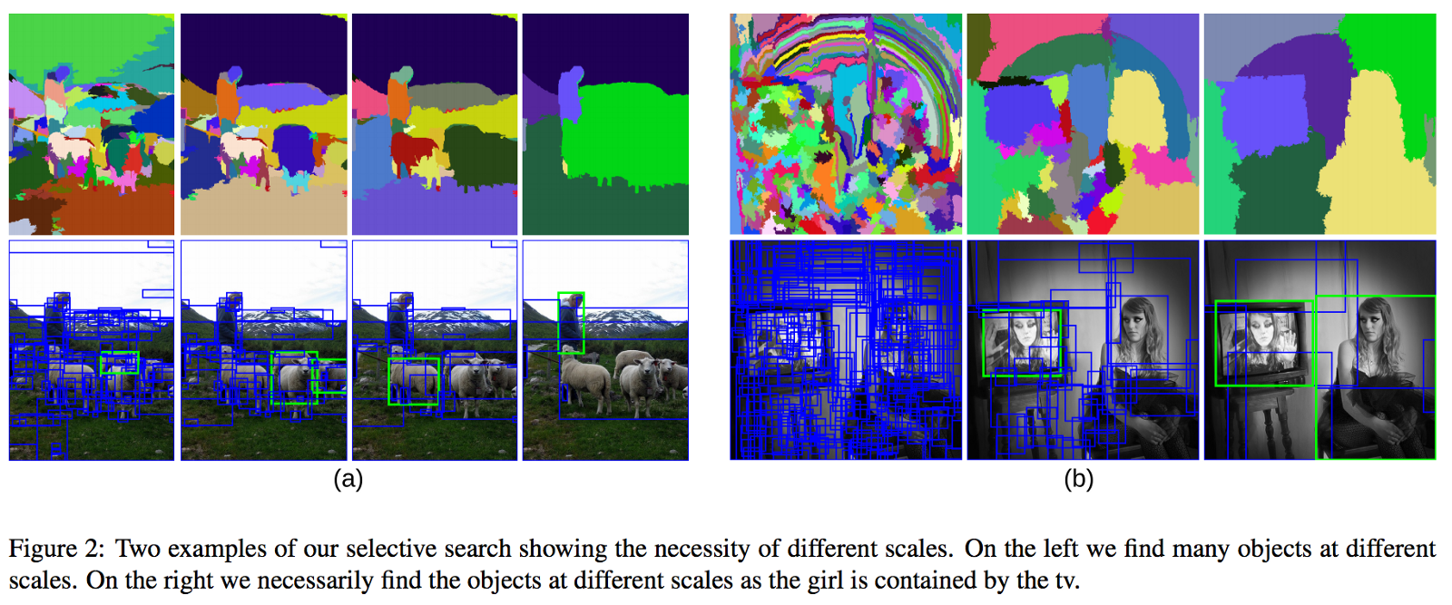
R-CNN: Goal
The goal of R-CNN is to take in an image, and correctly identify where the main objects (via a bounding box) in the image.
how do we find out where these bounding boxes are? R-CNN does what we might intuitively do as well - propose a bunch of boxes in the image and see if any of them actually correspond to an object.

Slide 5
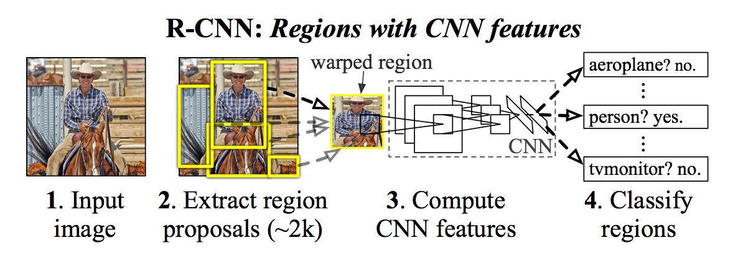
R-CNN: Overview
R-CNN creates these bounding boxes, or region proposals, using a process called Selective Search.
At a high level, Selective Search (shown in the image right) looks at the image through windows of different sizes, and for each size tries to group together adjacent pixels by texture, color, or intensity to identify objects.
Once the proposals are created, R-CNN warps the region to a standard square size and passes it through to a modified version of AlexNet
On the final layer of the CNN, R-CNN adds a Support Vector Machine (SVM) that simply classifies whether this is an object, and if so what object. This is step 4 in the image shown right side.

Slide 6
R-CNN: Overview
Now, having found the object in the box, can we tighten the box to fit the true dimensions of the object? We can, and this is the final step of R-CNN. R-CNN runs a simple linear regression on the region proposal to generate tighter bounding box coordinates to get our final result. Here are the inputs and outputs of this regression model:
Inputs: sub-regions of the image corresponding to objects.
Outputs: New bounding box coordinates for the object in the sub-region.

Slide 7
R- CNN Problems
R-CNN works really well, but is really quite slow for a few simple reasons:
It requires a forward pass of the CNN (AlexNet) for every single region proposal for every single image (that’s around 2000 forward passes per image!).
It has to train three different models separately - the CNN to generate image features, the classifier that predicts the class, and the regression model to tighten the bounding boxes. This makes the pipeline extremely hard to train.
In 2015, Ross Girshick, the first author of R-CNN, solved both these problems, leading to the second algorithm in our short history - Fast R-CNN. Let’s now go over its main insights.

Slide 8
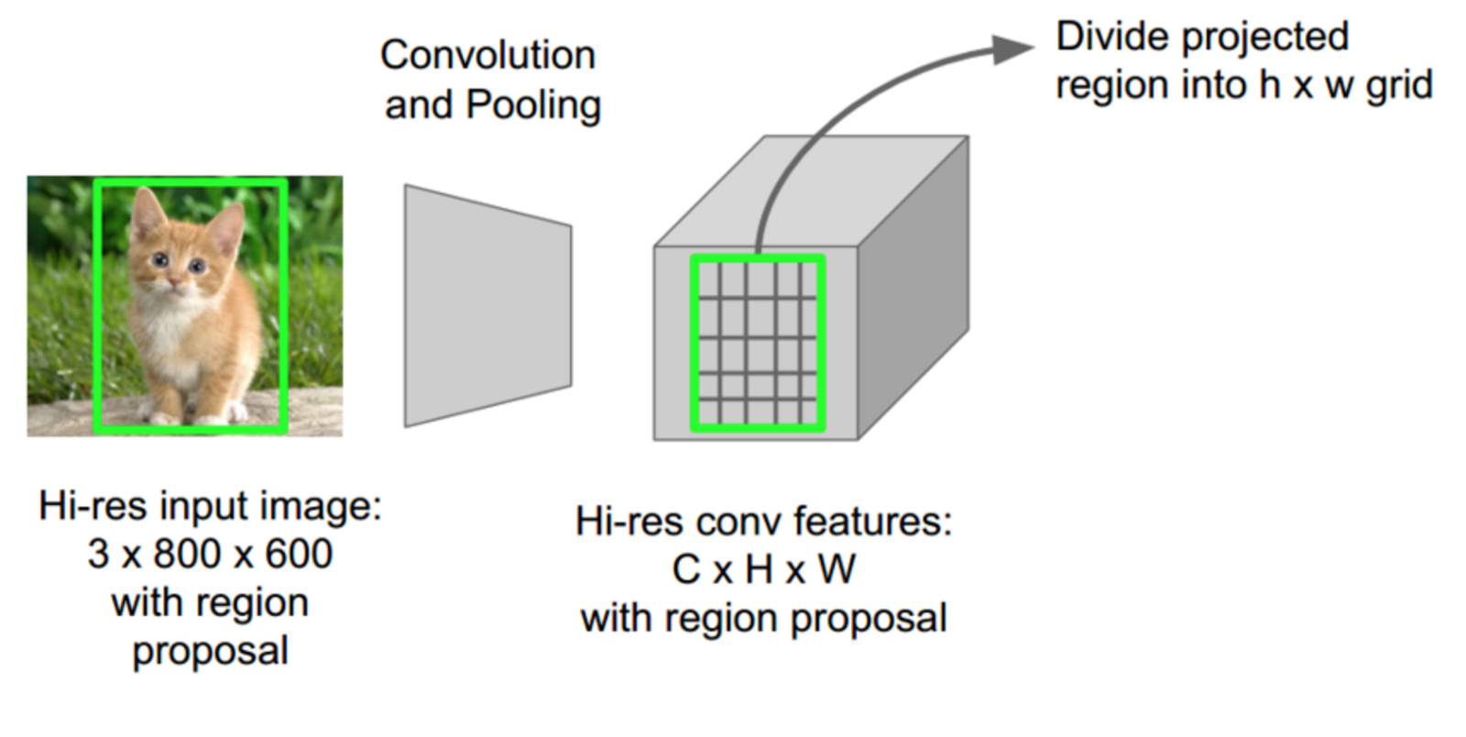
Fast R-CNN Insight 1: ROI (Region of Interest) Pooling
For the forward pass of the CNN, Girshick realized that for each image, a lot of proposed regions for the image invariably overlapped causing us to run the same CNN computation again and again (~2000 times!). His insight was simple — Why not run the CNN just once per image and then find a way to share that computation across the ~2000 proposals?

Slide 9

Fast R-CNN: Insight1
This is exactly what Fast R-CNN does using a technique known as RoIPool (Region of Interest Pooling).
At its core, RoIPool shares the forward pass of a CNN for an image across its subregions.
In the image above, notice how the CNN features for each region are obtained by selecting a corresponding region from the CNN’s feature map.
Then, the features in each region are pooled (usually using max pooling). So all it takes us is one pass of the original image as opposed to ~2000!

Slide 10
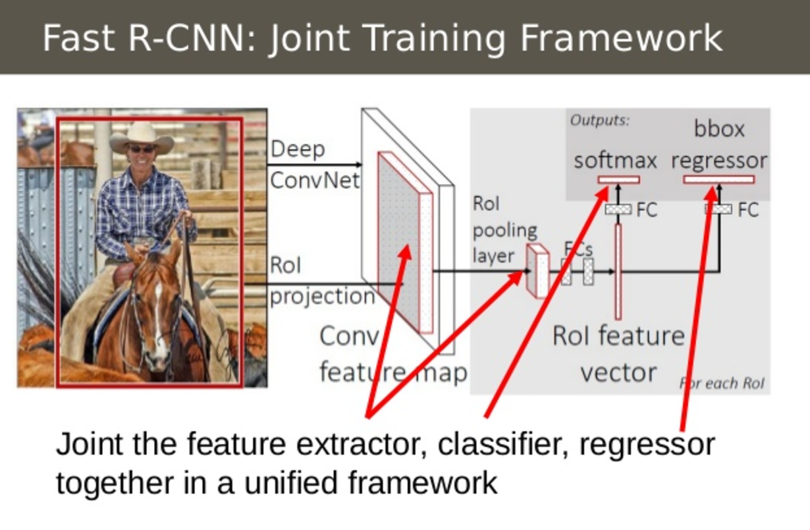
Fast R-CNN Insight 2: Combine All Models into One Network
The second insight of Fast R-CNN is to jointly train the CNN, classifier, and bounding box regressor in a single model. Where earlier we had different models to extract image features (CNN), classify (SVM), and tighten bounding boxes (regressor), Fast R-CNN instead used a single network to compute all three.

Slide 11
Fast R-CNN: Insight2
Fast R-CNN replaced the SVM classifier with a softmax layer on top of the CNN to output a classification.
It also added a linear regression layer parallel to the softmax layer to output bounding box coordinates.
In this way, all the outputs needed came from one single network! Here are the inputs and outputs to this overall model

Slide 12
ROI Pooling
The Network first processes the whole image with several convolutional and max pooling layers to produce a conv feature map.
ROI Pooling – Region of interest pooling
This is an operation widely used in object detection tasks using convolutional neural networks.
This pooling layer extracts a fixed-length feature vector from the feature map and is fed into a sequence of fully connected networks.
It’s purpose is to perform max pooling on inputs of nonuniform sizes to obtain fixed size feature maps.
(r , c , h , w) where (r, c ) specifies top-left corner and (h, w ) specifies height and width.

Slide 13
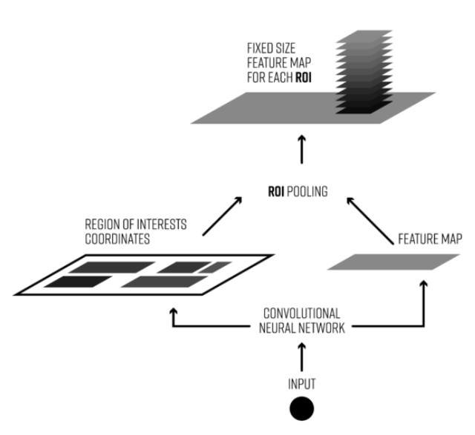
Fast R-CNN: Typical process of ROI Pooling
Dividing the region proposal into equal sized sections.
Finding the largest value in each section
Copying these max values to the output buffer.

Slide 14

Fast R-CNN: Overview
Inputs: Images with region proposals.
Outputs: Object classifications of each region along with tighter bounding boxes.
Fast R-CNN was successful in using a single network.

Slide 15

Fast R-CNN: Problems
Fast R-CNN had a problem with the region processor.
Proposals were done using selective search.
The insight of Faster R-CNN was that region proposals depended on features of the image that were already calculated with the forward pass of the CNN.

Slide 16
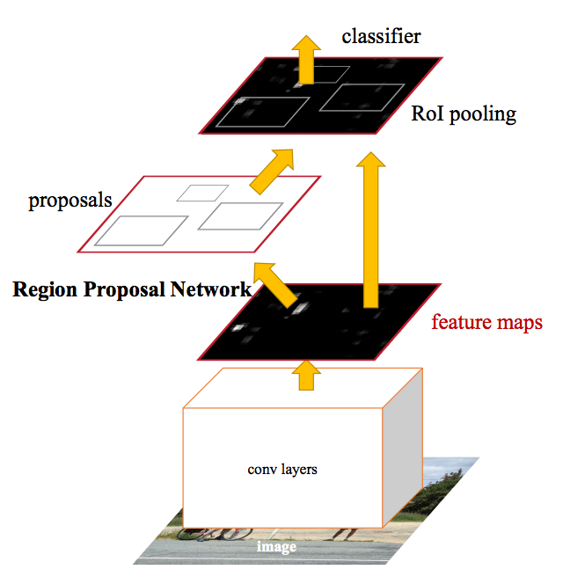
Faster R-CNN
Insert a Region Proposal Network (RPN) after the last convolutional layer.
RPN trained to produce region proposals directly.
After RPN, same as Fast R-CNN.
Presented in 2016.
In short, Faster R-CNN=RPN + Fast R-CNN
Approaches of training
Alternating training
Approximate joint training

Slide 17
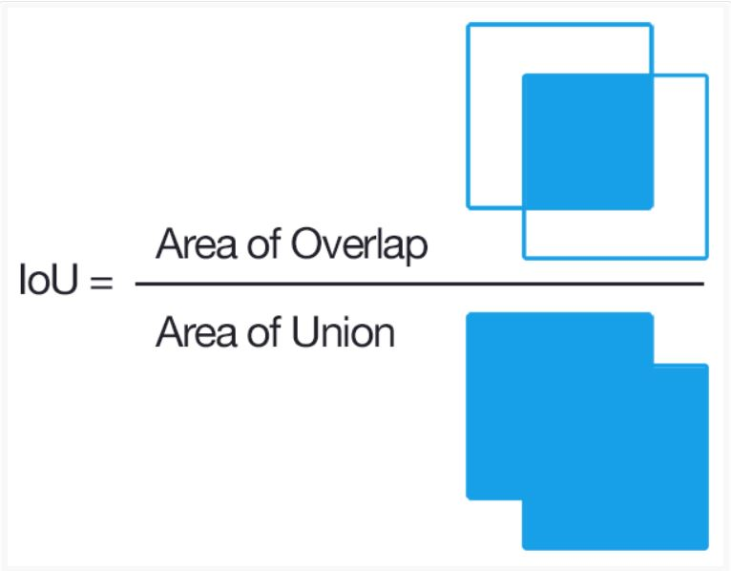
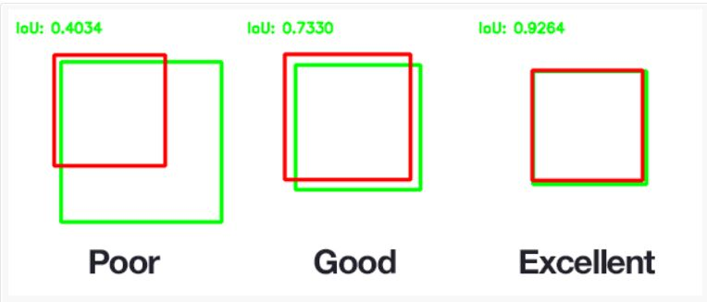
Faster R-CNN: positive/negative samples
An anchor is labeled as positive if the anchor box is the one with highest IoU overelap i.e., > 0.7
And negative if IoU values are less than 0.3

Slide 18
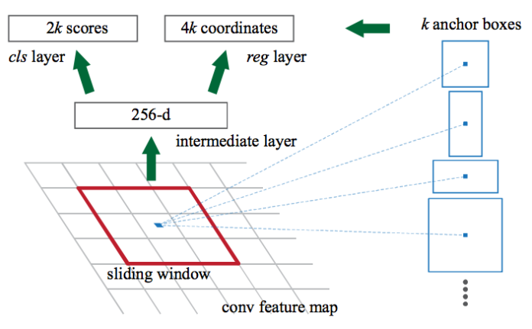
Region Proposal Network
RPN works by passing a sliding window over the CNN feature map and at each window outputting k potential anchor boxes based on certain aspect ratios and sizes.

Slide 19
Faster R-CNN: Results
 | R-CNN | Fast R-CNN | Faster R-CNN
Test time per image (with proposals) | 50 seconds | 2 seconds | 0.2 seconds
(Speedup) | 1x | 25x | 250x
mAP(VOC 2007) | 66.0 | 66.9 | 66.9

Slide 20
Thank You

